Slide 1
VLSI TECHNOLOGY

Slide 2
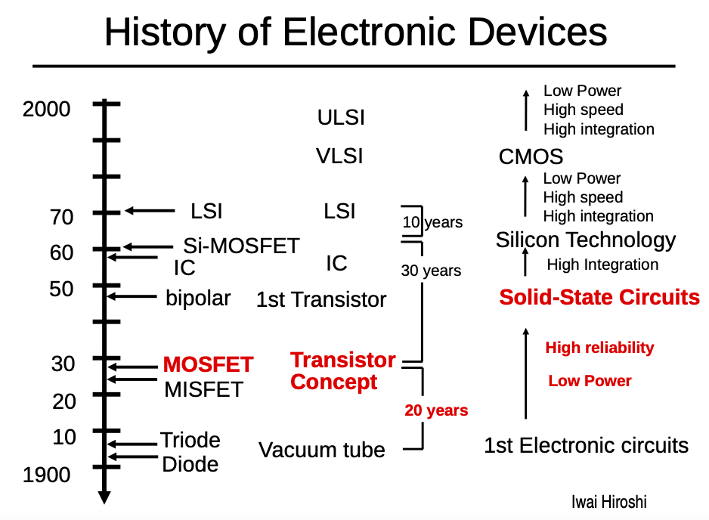

Slide 3
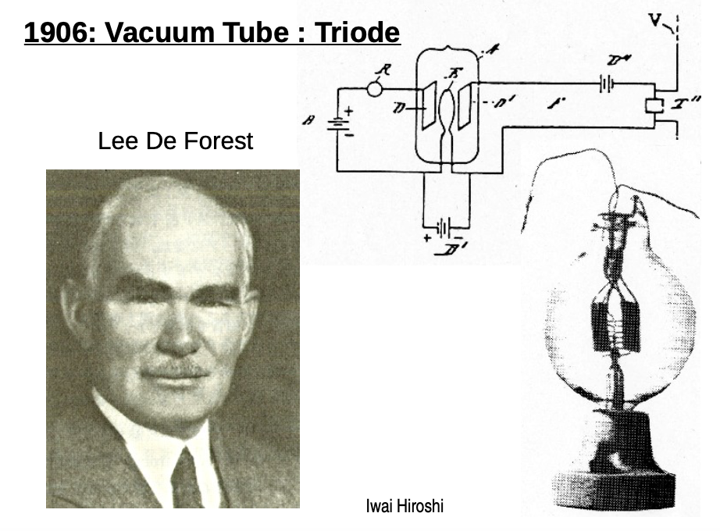

Slide 4
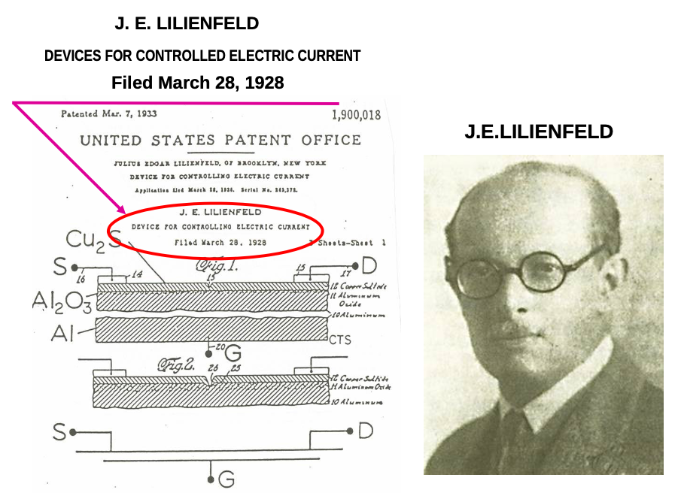

Slide 5
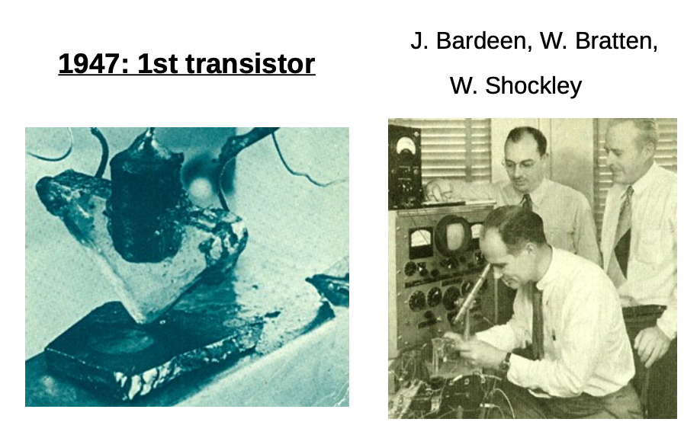

Slide 6
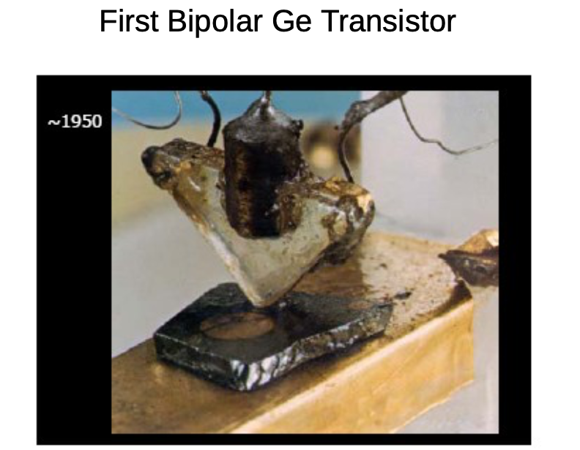

Slide 7
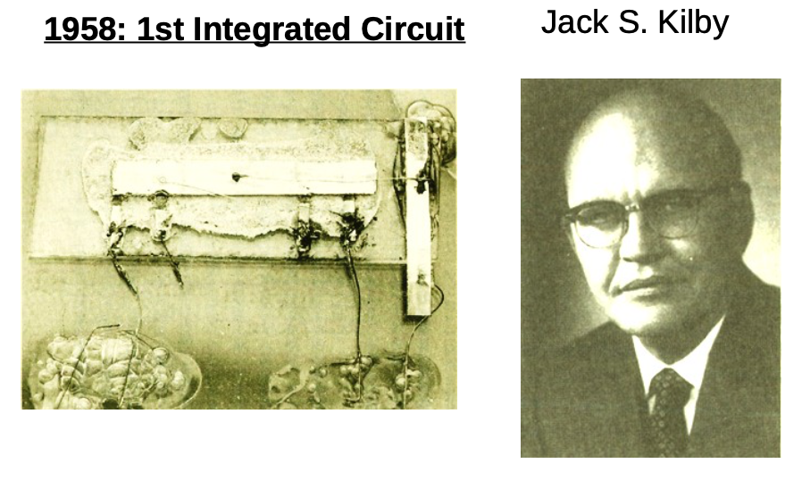

Slide 8
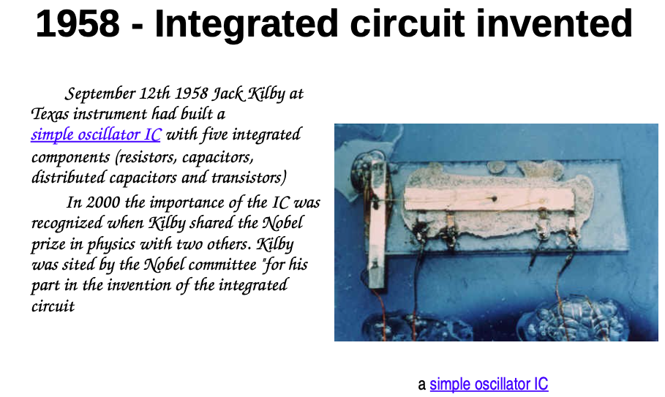

Slide 9
Ten years later, Jack Kilby at Texas Instruments realized the potential for miniaturization if multiple transistors could be built on one piece of silicon.
first prototype of an integrated circuit, constructed from a germanium slice and gold wires.
The invention of the transistor earned the Nobel Prize in Physics in 1956 for Bardeen, Brattain, and their supervisor William Shockley. Kilby received the Nobel Prize in Physics in 2000 for the invention of the integrated circuit.

Slide 10
Transistors can be viewed as electrically controlled switches with a control terminal and two other terminals that are connected or disconnected depending on the voltage or current applied to the control.
Soon after inventing the point contact transistor, Bell Labs developed the bipolar junction transistor. Bipolar transistors were more reliable, less noisy, and more power-efficient.
Early integrated circuits primarily used bipolar transistors. Bipolar transistors require a small current into the control (base) terminal to switch much larger currents between the other two (emitter and collector) terminals.

Slide 11
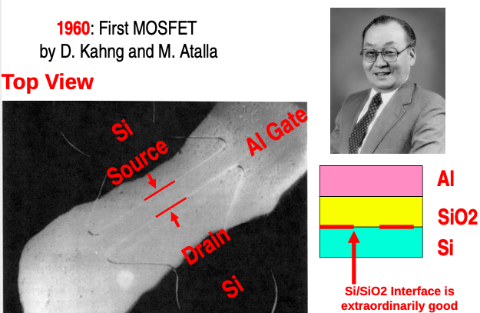

Slide 12
The quiescent power dissipated by these base currents, drawn even when the circuit is not switching, limits the maximum number of transistors that can be integrated onto a single die.
By the 1960s, Metal Oxide Semiconductor Field Effect Transistors (MOSFETs) began to enter production.
MOSFETs offer the compelling advantage that they draw almost zero control current while idle.
They come in two flavors: nMOS and pMOS, using n-type and p-type silicon, respectively.

Slide 13
In 1963, Frank Wanlass at Fairchild described the first logic gates using MOSFETs. Fairchild’s gates used both nMOS and pMOS transistors, earning the name Complementary Metal Oxide Semiconductor, or CMOS.
MOS integrated circuits became attractive for their low cost because each transistor occupied less area and the fabrication process was simpler.
Early commercial processes used only pMOS transistors and suffered from poor performance, yield, and reliability. Processes using nMOS transistors became common in the 1970s.

Slide 14
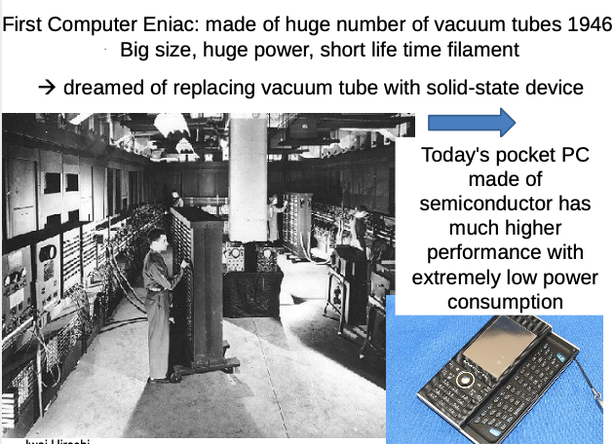

Slide 15
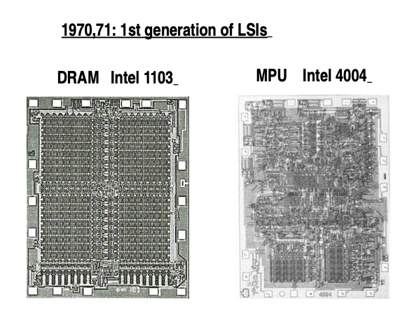

Slide 16
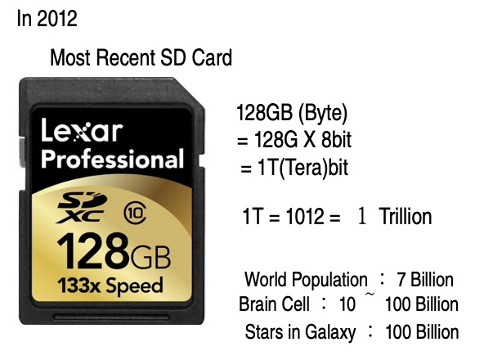

Slide 17
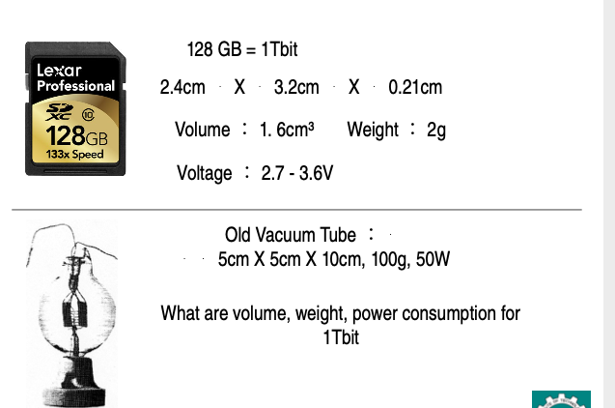

Slide 18
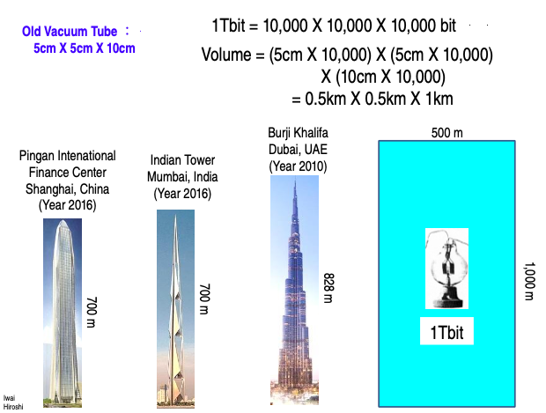

Slide 19
MOORE’S LAW
In 1965, Gordon Moore observed that plotting the number of transistors that can be most economically manufactured on a chip gives a straight line on a semilogarithmic scale
he found transistor count doubling every 18 months.
This observation is called Moore’s law
Moore’s Law is driven primarily by scaling down the size of transistors and, to a minor extent, by building larger chips.

Slide 20
LEVEL of INTEGRATION
The level of integration of chips has been classified as small-scale, medium-scale, large-scale, and very large- scale.
Small-scale integration (SSI) circuits, such as the 7404 inverter, have fewer than 10 gates
Medium-scale integration (MSI) circuits, such as the 74161 counter, have up to 1000 gates.
Large-scale integration (LSI) circuits, such as simple 8-bit microprocessors, have up to 10,000 gates

Slide 21
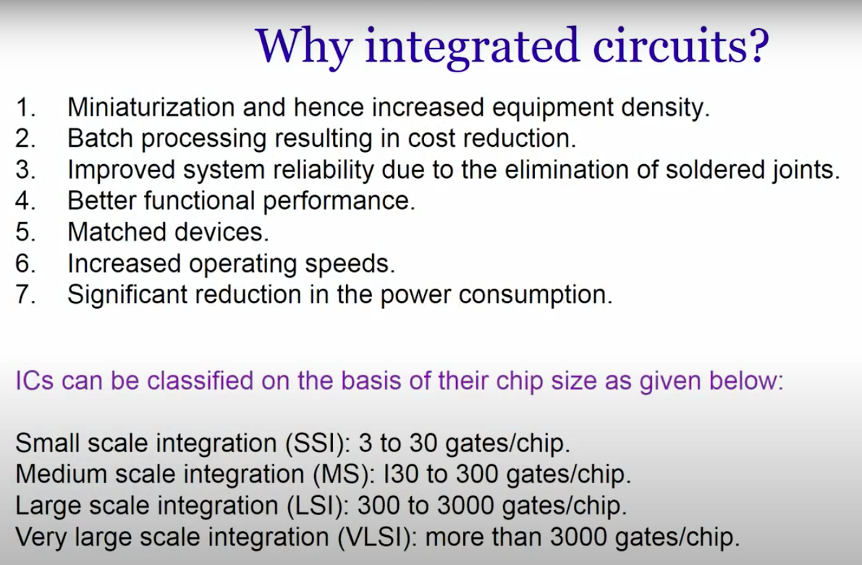

Slide 22
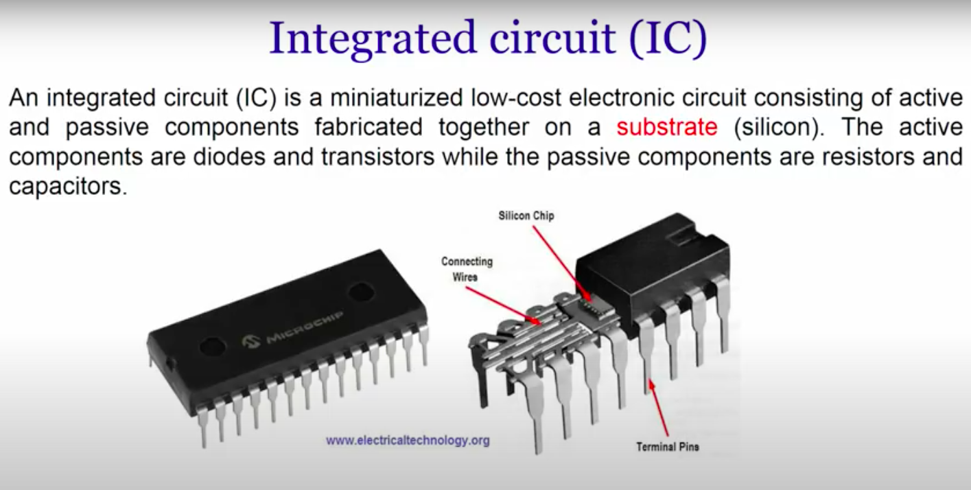

Slide 23
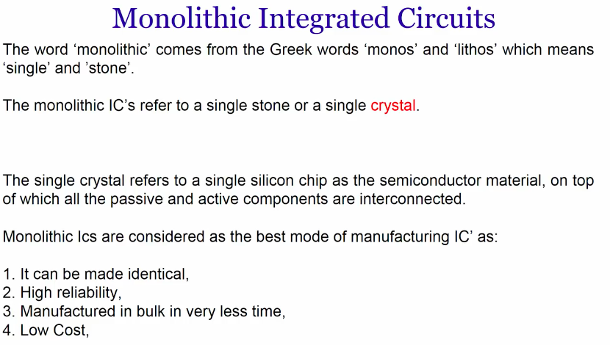

Slide 24
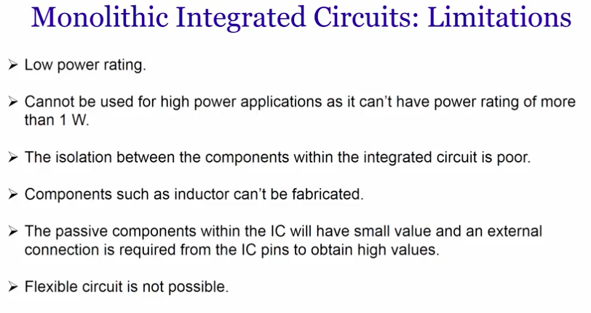

Slide 25
